Slide 1
UNIT-1 - INTRODUCTION
21ECE324T-ADVANCED MOBILE COMMUNICATION SYSTEMS

Slide 2
UNIT-1 SYLLABUS
Overview -What Is 5G? -Background -Research and Challenges for Electronics -Expected 5G in Practice - 5G and Security -Motivations -5G Standardization and Regulation -Global Standardization in 5G Era. 5G; Requirements Based on ITU- The Technical Specifications of 3GPP-The 5 G Security.
Case Study: Mobile Network Operators and Mobile Device Manufacturers in India

Slide 3
Evolution of Cellular Technologies

Slide 4
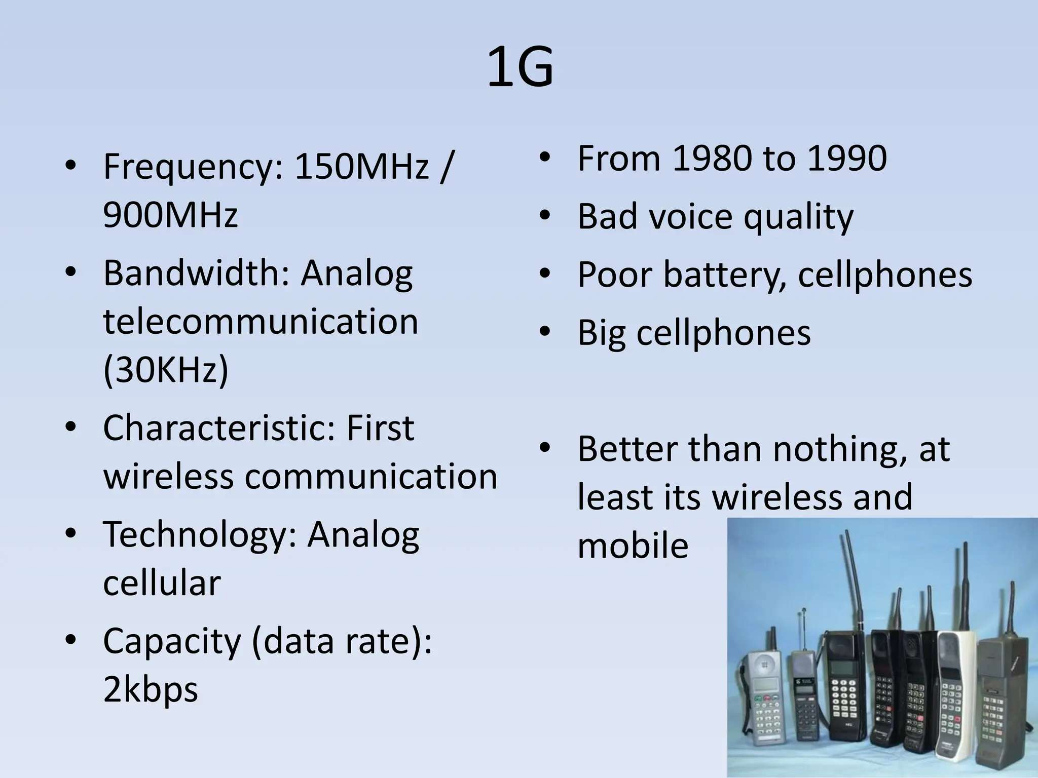

Slide 5
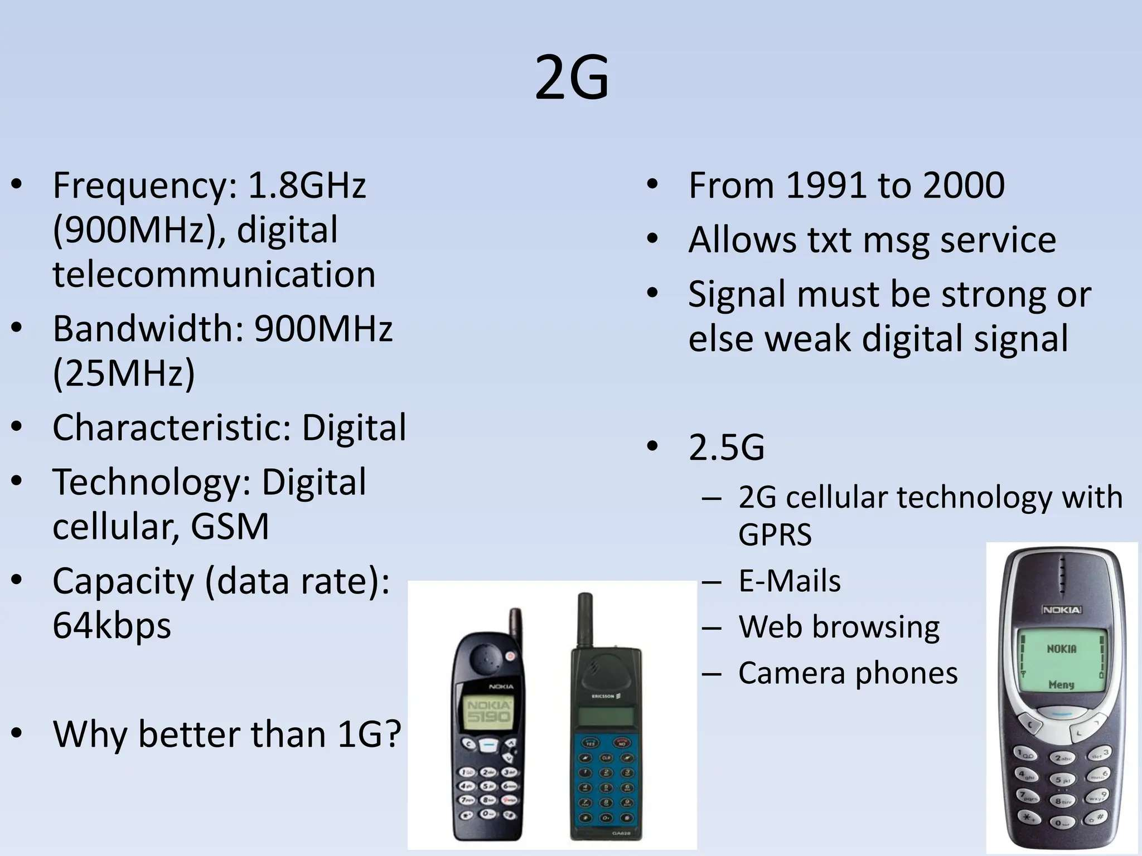

Slide 6
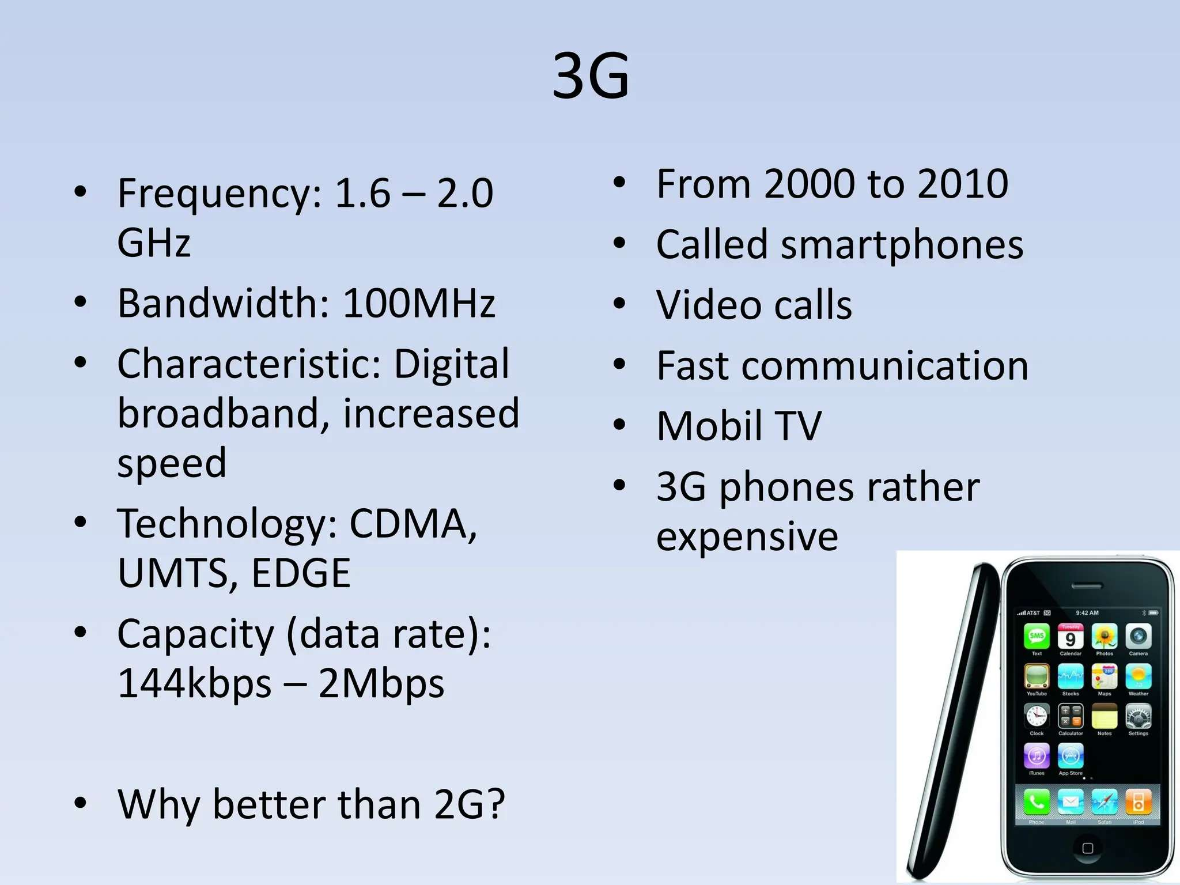

Slide 7
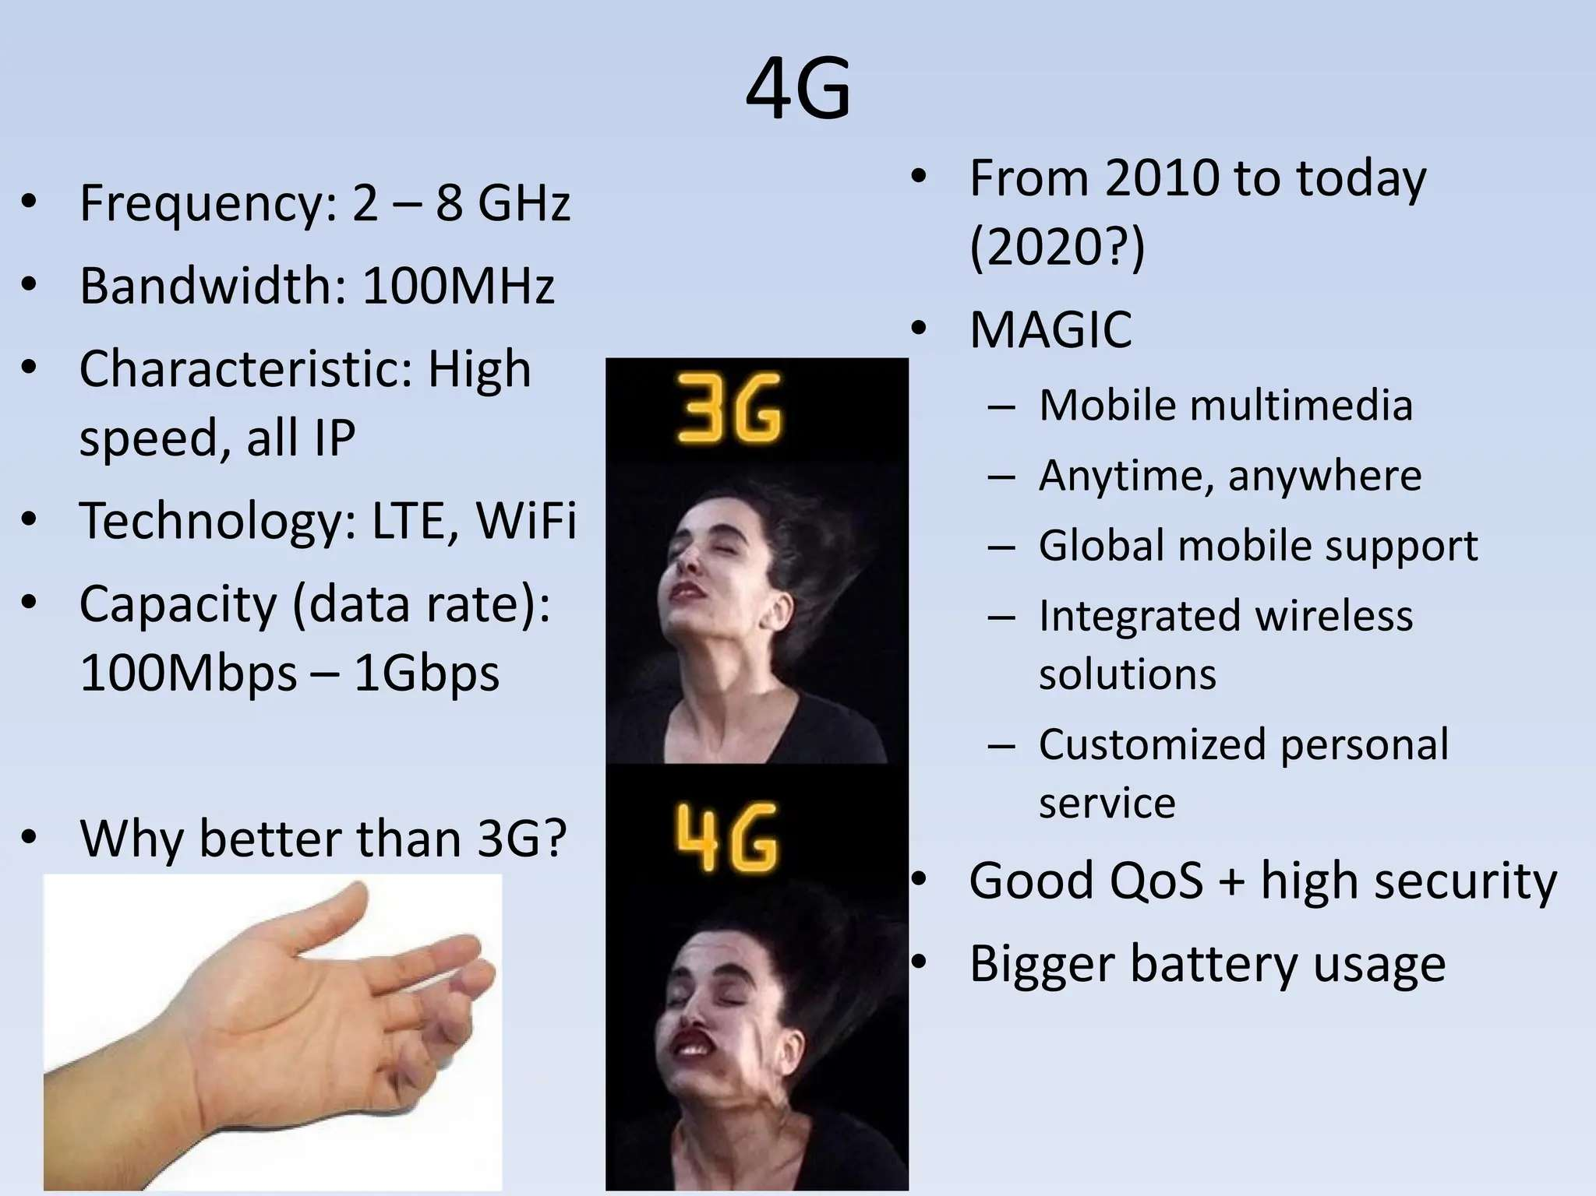

Slide 8
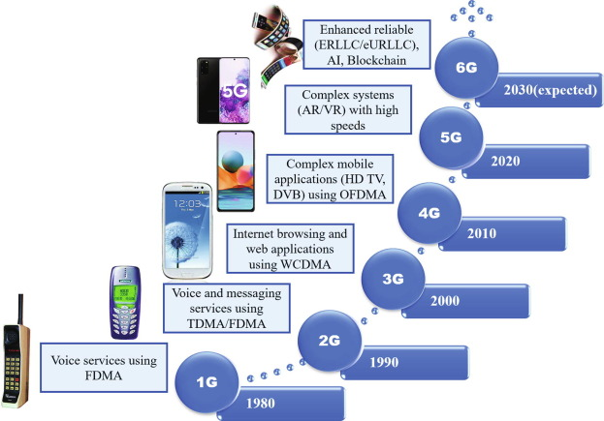
EVOLUTION

Slide 9
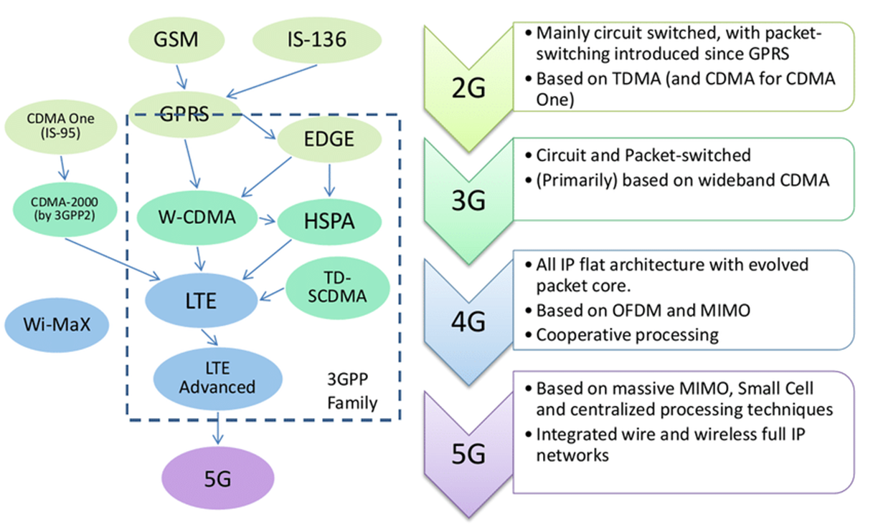
EVOLUTION

Slide 10
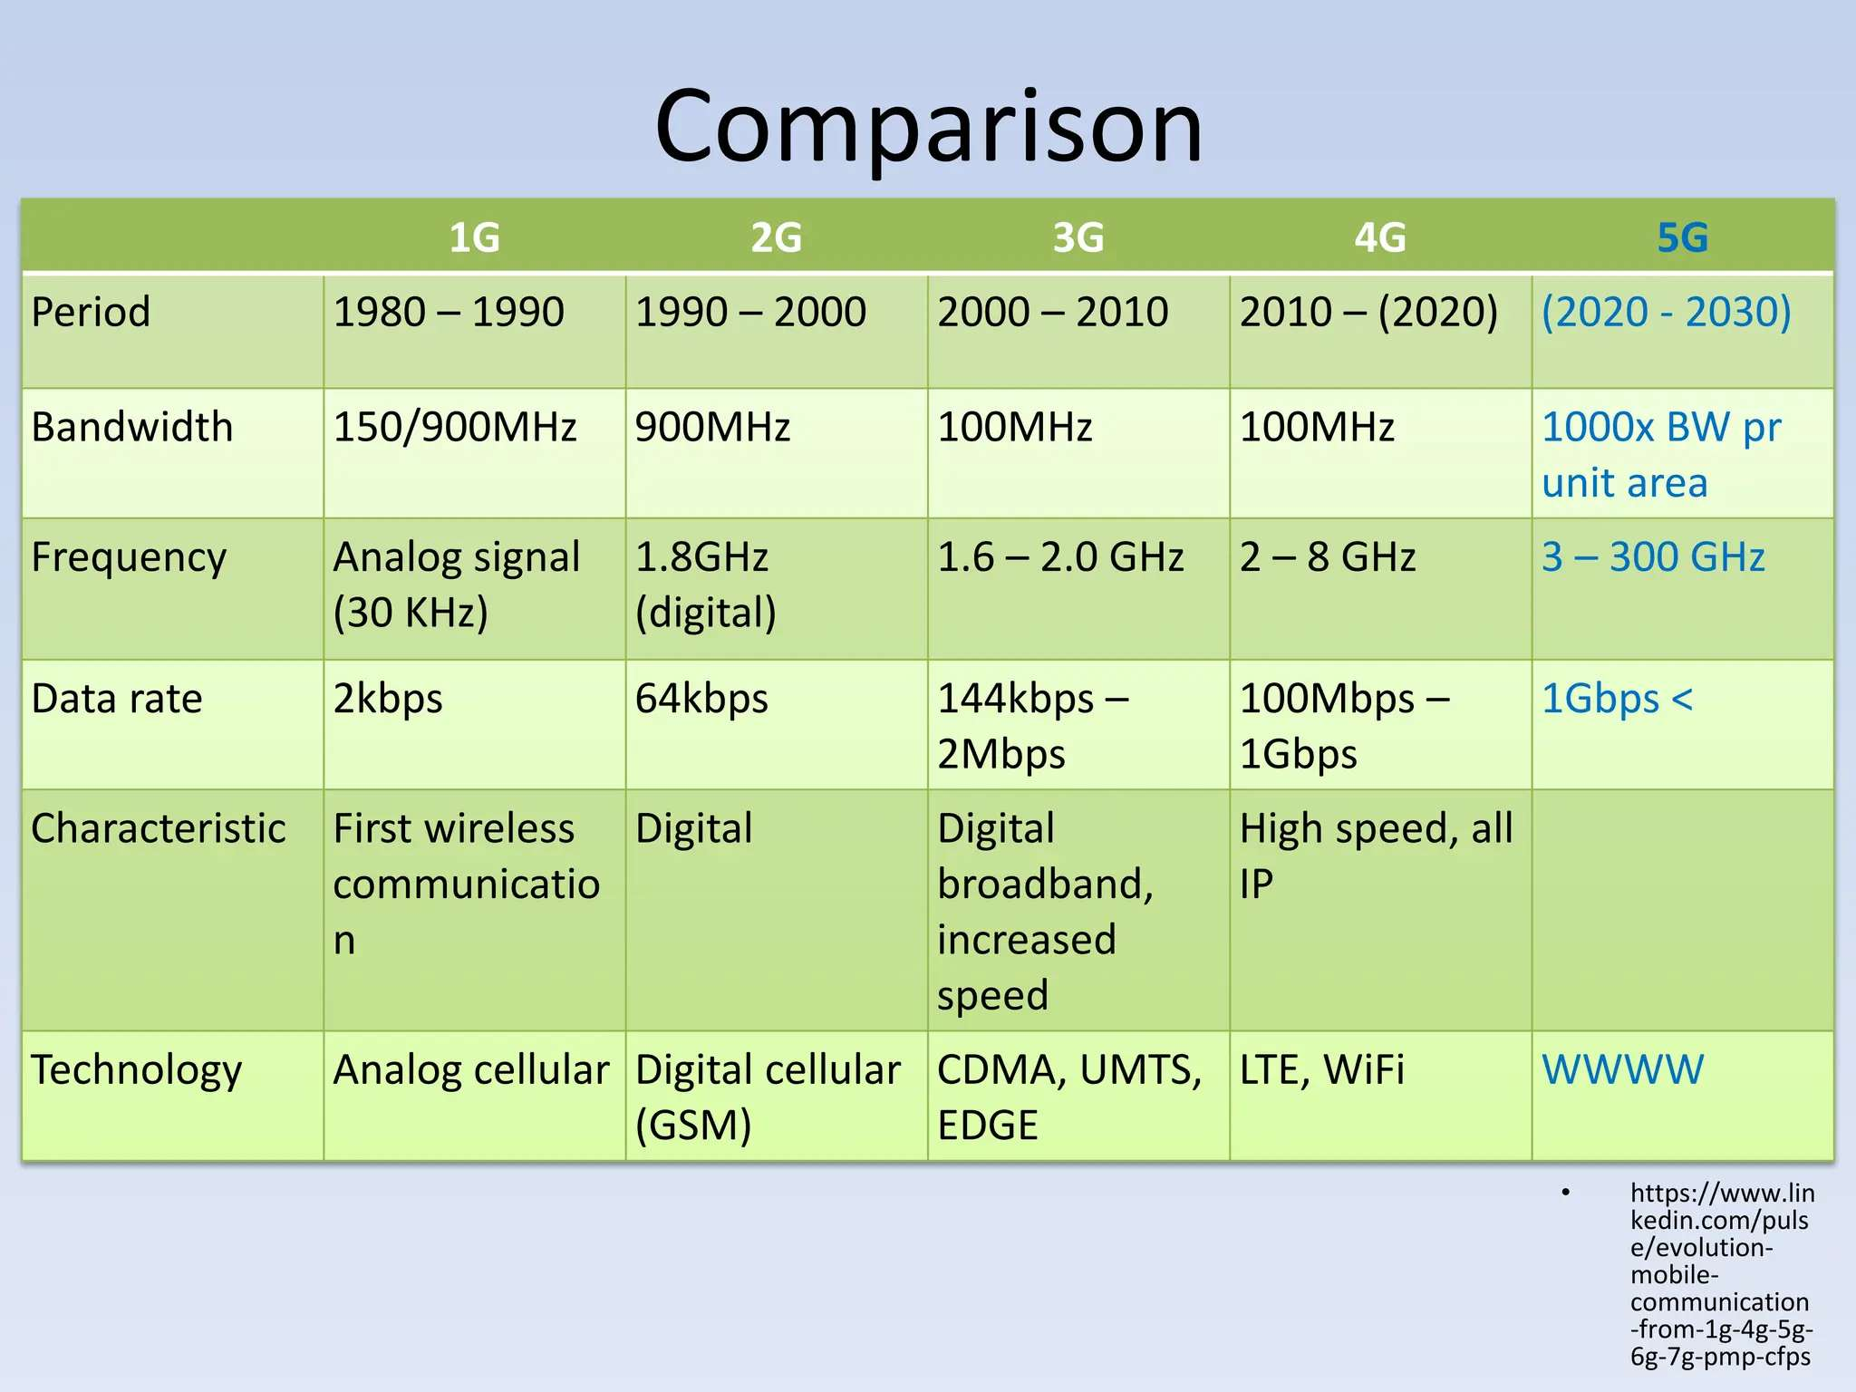
COMPARISON

Slide 11
UNIT 1

Slide 12
Overview
Regardless of the high performance of 4G systems, the telecom industry has identified a need for faster end-user data rates due to constantly increasing performance requirements of the evolving multimedia.
5G systems have thus been designed to cope with these challenges by providing more capacity and enhanced user experiences for VIRTUAL REALITY
At the same time, the exponentially enhancing and growing number of IoT (Internet of Things) devices requires new security measures such as security breach monitoring, prevention mechanisms, and novelty manners to tackle the vast challenges the current and forthcoming IoT devices bring along.
As there have been more concrete development and field testing activities by major operators, as well as agreements for the forthcoming 5G frequency allocation regulation by International Telecommunications Union (ITU) World Radio Conference (WRC) 19, and deployment aspects of 5G based on the available information during 2018 and basing on the first phase of the 3rd Generation Partnership Project (3GPP) Release 15, which is the starting point for the gradual 5G deployment.

Slide 13
What Is 5G?
The term 5G refers to the forthcoming International Mobile Telecommunications (IMT)-2020 requirements of ITU-R (radio section of the International Telecommunications Union).
5G provides much faster data rates with very low latency compared to the current systems up to 4G.
The industry seems to agree that 5G is, in fact, a combination of novel (yet to be developed and standardized) solutions and existing systems basing on 4G Long-Term Evolution (LTE)-Advanced, as well as non-3GPP access technologies such as Wi-Fi, which jointly contributes to optimizing the performance (providing at least 10 times higher data rate compared to current LTE-Advanced networks), lower latency (including single-digit range in terms of millisecond), and support of increased capacity demands for huge amounts of simultaneously connected consumer and machine-to-machine, or M2M, devices.
Because of the key enablers of 5G, some of the expected highly enhanced use cases would include also the support of tactile Internet and augmented, virtual reality, which provide completely new, fluent, and highly attractive user experiences never seen before.
Various mobile network operators (MNOs) and device manufacturers have been driving the technology via concrete demos and trials need for global 5G interoperability.

Slide 14
Background
During 2016–2017, there were countless public announcements on the expected 5G network deployments while the 4G deployment was still in its most active deployment phase. Up to the third-generation mobile communication networks, the terminology has been quite understandable, as 3G refers to a set of systems that comply with the IMT-2000 (International Mobile Telecommunications for 3G) requirements designed by the ITU. Thus, the Cdma2000,UniversalMobile Telecommunications System (UMTS)/High Speed Packet Access (HSPA) and their respective evolved systems belong to the third generation as the main representatives of this era.
The definition of the fourth generation is equally straightforward, based on the ITU’s IMT-Advanced requirements. While 3G had multiple representatives in practice, there are only two systems fulfilling the official, globally recognized 4G category as defined in IMT-Advanced, and they are the 3GPP LTE-Advanced as of Release 10, and the IEEE 802.16m referred to also as WiMAX.The first 3GPP Release 8 and Release 9 LTE networks were deployed in 2010–2011, and their most active commercialization phase took place around 2012–2014. Referring to ITU-terminology, these networks prior to Release 10 still represented the evolved 3G era, which, as soon as they were upgraded, resulted in the fully compatible 4G systems.
While 4G was still being developed, the 5G era generated big interest. The year 2017 was a concrete show-time for many companies for demonstrating how far the technical limits could be pushed. Some examples of these initiations, among many others, included Verizon 5G Technology Forum, which included partners in the Verizon innovation centers, and Qualcomm, which demonstrated the capabilities of LTE Advanced Pro via millimeter-wave setup.

Slide 15
Background
These examples and other demos and field trials prior to the commercial deployment of 5G indicated the considerably enhanced performance and capacity that the 5G provides, although fully deployed, Phase 2 of 5G as defined by 3GPP is still set to the 2020 time frame. As soon as available, the 5G era will represent something much more than merely a set of high-performance mobile networks. It will, in fact, pave the way for enabling a seamlessly connected society with important capabilities to connect a large number of always-on IoT devices. The idea of 5G is to rely on both old and new technologies on licensed and unlicensed radio frequency (RF) bands that are extended up to several GHz bands to bring together people, things, data, apps, transport systems and complete cities, to mention only some – in other words, everything that can be connected. The 5G thus functions as a platform for ensuring smooth development of the IoT, and it also acts as an enabler for smart networked communications. This is one of the key statements of ITU, which eases this development via the IMT-2020 vision.
The important goal of 5G standard is to provide interoperability between networks and devices, to offer high capacity energy-efficient and secure systems, and to remarkably increase the data rates with much less delay in the response time. Nevertheless, the 5th generation still represents a set of ideas for highly evolved system beyond the 4G. As has been the case with the previous generations, the ITU has taken an active role in coordinating the global development of the 5G.

Slide 16
Research
There are several research programs established to study the feasibility and performance of new ideas in academic level. As an example, the European Union (EU) coordinates 5G research programs under various teams. More information about the latest European Commission (EC) funded 5G research plans can be found in EU web page, which summarizes 5G initiatives. As stated by EU, the 5G of telecommunications systems will be the most critical building block of our digital society in 2020–2030. Europe has taken significant steps to lead global developments toward this strategic technology. Furthermore, EU has recognized that the 5G will be the first instance of a truly converged network environment where wired and wireless communications will use the same infrastructure, driving the future networked society. EU states that 5G will provide virtually ubiquitous, ultra-high bandwidth connectivity not only to individual users but also to connected objects. Therefore, it is expected that the future 5G infrastructure will serve a wide range of applications and sectors, including professional uses such as assisted driving, eHealth, energy management, and possibly safety applications.

Slide 17
Research
The EC study programs include FP7 teams and METIS (Mobile and wireless communications Enablers for Twenty-twenty (2020) Information Society), and other internationally recognized entities. One of the international joint activities is the cooperation between EU and Brazil.
As for the 5G radio capacity needs on the current bands, the European Commission aims to coordinate the use of the 700MHz band for mobile services to provide higher-speed and higher-quality broadband and cover wider areas, including rural and remote regions. The concrete goal of EU is to provide mobile broadband speeds beyond 100Mb/s.

Slide 18
Challenges for Electronics
One of the expected key abilities of the 5G networks is the high-energy efficiency to cope with a big amount of low-power IoT devices in the field. The benefits include better cost-efficiency, sustainability, and widening the network coverage to remote areas. Some of the base technologies for facilitating the low energy include advanced beamforming as well as radio interface optimization via user-data and system-control plane separation.
Other technologies include reliance on virtualized networks and clouds. The systems also need to be developed at the component level for both networks and devices. Autonomously functioning remote IoT devices require special attention, as they must function reliably typically several years without human interaction or maintenance. The advances in the more efficient battery technologies are thus in key position. Also, the very small devices such as consumer wearables and M2M sensor equipment may require much smaller electronical component form factors, including tiny wafer-level subscriber modules that still comply with the demanding reliability and durability requirements in harsh conditions. At the same time, the need for enhanced security aspects will require innovative solutions in the hardware (HW) and software (SW) levels.

Slide 19
Expected 5G in Practice
The 5G is a result of a long development of mobile communications, with roots going back to the 1980s when the first-generation mobile communications networks began to be reality. Ever since the first data services, which the 2G systems started to include around the mid-1990s, the new generations up to 4G have been based on the earlier experiences and learnings, giving the developers a base for designing enhanced technologies for the access, transport, signaling, and overall performance of the systems. Figure 1.1 depicts the development of the data rates of the 3G, 4G, and 5G systems.
However, the telecom industry has identified a further need for considerably faster end-user data rates to cope with the demands of the evolving multimedia. The 5G could handle these challenging capacity requirements to provide fluent user experiences even for the most advanced virtual reality applications. At the same time, the exponentially growing number of the IoT devices require new security measures, including potential security-breach monitoring and prevention.
Along with the new M2M and IoT applications and services, there will be role-changing technologies developed to support and complement the existing ones. The 5G is one of the most logical bases for managing this environment, together with the legacy systems in the markets.

Slide 20
Expected 5G in Practice
Although the 5G is still in its infancy until the ITU officially dictates its requirements and selects the suitable technologies from the candidates, the 5G systems will be reality soon. During the deployment and operation of 5G networks, we can expect to see many novelty solutions such as highly integrated wearable devices, household appliances, industry solutions, robotics, self-driving cars, virtual reality, and other advanced, always-on technologies that benefit greatly from enabling 5G platforms.
In addition to the “traditional” type of IoT devices such as wearable devices with integrated mobile communications systems (smart watch), car communications systems and utility meters, there are also emerging technology areas such as self-driving cars that require high reliability as for the functionality as well as for the secure communications, which 5G can tackle.
As Next Generation Mobile Networks (NGMN) states in [8], the 5G will address the demands and business contexts as of 2020 by enabling a fully mobile and connected society. This facilitates the socioeconomic transformations contributing to productivity, sustainability, and overall well-being. This is achieved via a huge growth in connectivity and volume of data communications. This, in turn, is possible to provide via advanced, multilayer densification in the radio network planning and providing much faster data throughput, considerably lower latency, and higher reliability and density of simultaneously communicating devices.

Slide 21
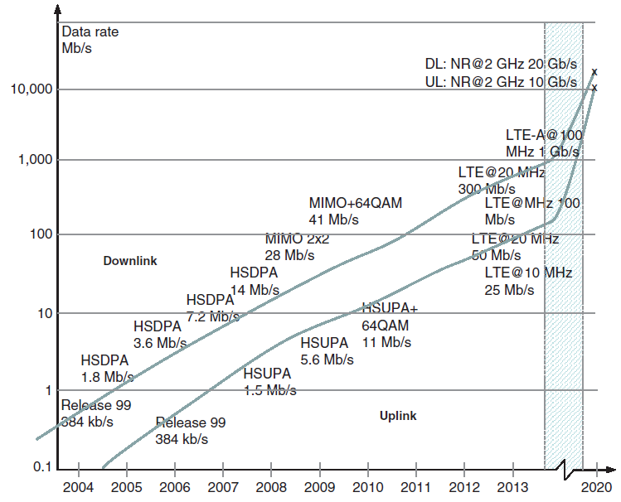
Expected 5G in Practice
Figure 1.1 The development of mobile data rates.

Slide 22
Expected 5G in Practice
In addition, to manage this new, highly complex environment, new means for managing and controlling the heterogeneous and highly energy-efficient environment is needed. One of the major needs is to ensure the proper security of the new 5G services and infrastructure, including protection of identity and privacy.
Another aspect in the advanced 5G system is the clearly better flexibility compared to any of the previous mobile communication generations. This refers to the optimal network resource utilization and providing new business models for variety of new stakeholders. This means that the 5G network functionality will be highly modular, which facilitates cost-efficient, on-demand scalability.
In practice, the above-mentioned goals are possible to achieve only via renewed radio interfaces, including totally new, higher frequencies and capacity enhancements for the accommodation of increasing the customer base in consumer markets as well as support for the expected huge amount of simultaneously communication IoT devices.
The 5G network infrastructure will be more heterogeneous than ever before, so there will be a variety of access technologies, end-user devices, and network types characterized by deeper multi-layering. The challenge in this new environment is to provide to the end-users as seamless a user experience as possible.
To achieve the practical deployment schedule for the mature 5G initiating the commercial era by 2020, 3GPP as well as supporting entities such as NGMN are collaborating with the industry and relevant standardization organizations covering both “traditional” teams as well as new, open-source-based standardization bodies.

Slide 23
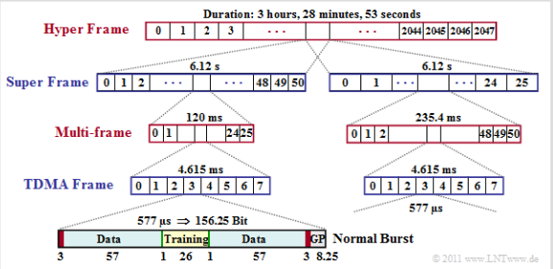
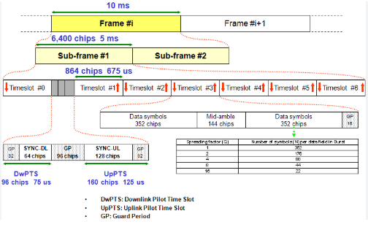
Frame structure
GSM
CDMA

Slide 24
5G and Security
As for the security assurance of the new 5G era, there can be impacts expected in the “traditional” forms of SIM (Subscriber Identity Module), Universal Integrated Circuit Card (UICC), and subscription types, as the environment will be much more dynamic. The ongoing efforts in developing interoperable subscription management solutions that respond in near real time for changing devices and operators upon the need of the users are creating one of the building blocks for the always connected society. It is still to be seen what the consumer and M2M devices will look like physically in the 5G era, but we might see much more variety compared to any previous mobile network generations, including multiple wearable devices per user and highly advanced control and monitoring equipment.
Along with these completely new types of devices, the role of the removable subscription identity modules such as SIM/UICC can change; the much smaller personal devices require smaller form factors. At the same time, the techniques to tackle with the constantly changing subscriptions between devices need to be developed further, as do their security solutions. The cloud-based security such as tokenization and host card emulation (HCE), as well as the development of the device-based technologies like Trusted Execution Environment (TEE) may be in key positions in the 5G era, although the traditional SIM/UICC can still act as a base for the high security demands.

Slide 25
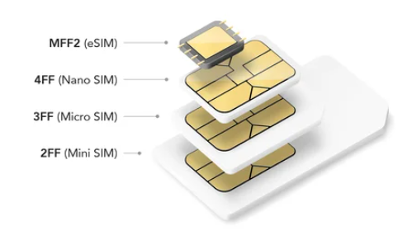
SIM vs ESIM (UICC)
A traditional UICC contains a single MNO profile, which usually has 64KB or 128KB of memory. An eUICC can host multiple profiles and requires a minimum memory of 512KB.

Slide 26
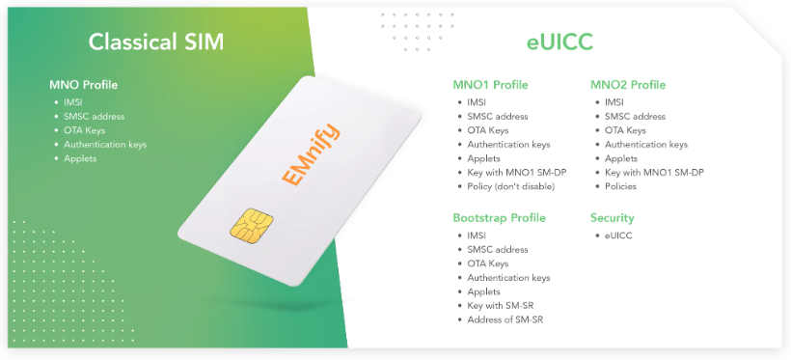
Modules in UCC

Slide 27
Motivations
One might wonder why yet another mobile communications generation is really needed. In fact, the fourth generation already provides quite impressive performance with low latency and high data rates.
The reasons are many-folded. Not only the increasing utilization of the mobile communications networks for ever-advancing applications including higher-definition video, virtual reality, and artificial intelligence require much more capacity even in remote areas, but – and one might argue if even primarily – the need is derived from the exponential increase of the IoT devices. The number of the intelligent sensors and other machines communicating with each other, service back-ends require support for much more simultaneously connected devices. The amount may be, as stated in one of the core requirements of the ITU, one million devices per km2, which outnumbers clearly even the theoretically achievable capacity the advanced 4G can offer. The 5G would thus benefit especially massive IoT development, the increased data rates for consumers being another positive outcome of the new technology.

Slide 28
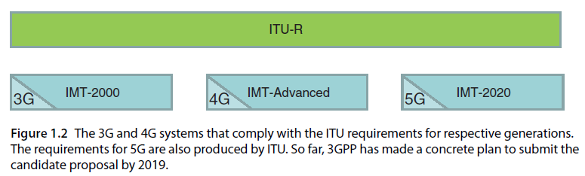
5G Standardization and Regulation A) ITU
The ITU-R is the highest-level authority for defining the universal principles of 5G. The ITU is thus planning to produce a set of requirements for the official 5G-capable systems under the term IMT-2020. As the term indicates, the commercial systems are assumed to be ready for deployment as of 2020. This follows the logical path for ITU-defined 3G and 4G, as depicted in Figure 1.2.

Slide 29
A) ITU Cont..
The IMT-2020 is in practice a program to describe the 5G as a next-evolution step after the IMT-2000 and IMT-Advanced, and it also sets the stage for the international 5G research activities. The aim of the ITU-R is to finalize the vision of 5G mobile broadband society which, in turn, is an instrumental base for the ITU’s frequency allocation discussions at the WRC events from which the WRC’15 was the most concrete session up today for discussing the 5G frequency strategies. The WRC decides the ways for reorganizing the frequency bands for the current and forthcoming networks, including the ones that will be assigned to the 5G.
Concretely, the Working Party 5D (WP5D) of ITU-R coordinates information sharing about the advances of 5G, including the vision and technical trends, requirements, RF sharing and compatibility, support for applications and deployments, and most importantly, the creation of the IMT-2020 requirement specifications.
ITU-R WP5D uses the same process for 5G as was applied to IMT-Advanced. Specifically for the 5G system evaluation process, the timeline of ITU is the following (Figure 1.3)
2016–2017. Performance requirements, evaluation criteria, and assessment methodology of new radio;
2018. Time frame for proposal;
2018–2020. Definition of the new radio interfaces;
2020. Process completed.

Slide 30
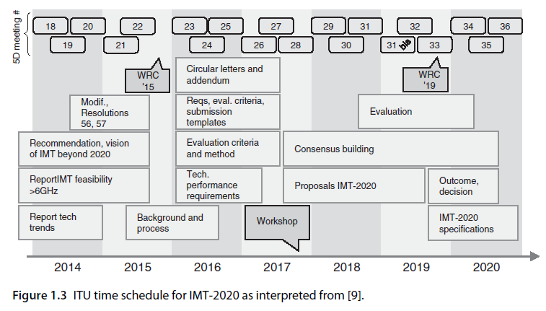

Slide 31
B) 3GPP
While ITU-R is preparing for the evaluation of the 5G candidate technologies that would be compatible with the 5G framework as seen by ITU, one of the active standardization bodies driving the practical 5G solutions is the 3GPP, which is committed to submitting a candidate technology to the IMT-2020 process. The 3GPP is aiming to send the initial technical proposal to the ITU-R WP5D meeting #32 in June 2019 and plans to provide the detailed specification by meeting #36 in October 2020. To align the technical specification work accordingly, the 3GPP has decided to submit the final 5G candidate proposal based on the further evolved LTE-Advanced specifications, as will be their status by December 2019. In addition to the 3GPP, there may also be other candidate technologies seen, such as an enhanced variant of IEEE 802.11.
As for the 3GPP specifications, 5G will affect several technology areas of radio and core networks. The expected aim is to increase the theoretical 4G data rates perhaps 10–50 times higher whilst the response time of the data would be reduced drastically, close to zero. The 3GPP RAN TSG (Radio Access Network Technical Specification Group) is the responsible entity committed to identify more specifically these requirements, scope, and 3GPP requirements for the new radio interface. The RAN TSG works in parallel fashion for enhancing the ongoing LTE evolution that belongs to the LTE-Advanced phase of the 3GPP, aiming to comply with the future IMT-2020 requirements of the ITU. At the same time, the evolved core network technologies need to be revised by the system architecture teams so that they can support the increased data rates accordingly.
3GPP is committed to submitting a candidate technology to the IMT 2020 process based on the following time schedule, as described in the reference SP-150149 (5G timeline in 3GPP) (Figure 1.4):
June 2018. Release 15, Stage 3 freeze;
June 2019. Initial technology submission by ITU-RWP5D meeting #32;
October 2020. Detailed specification submission by ITU-RWP5D meeting #36.

Slide 32
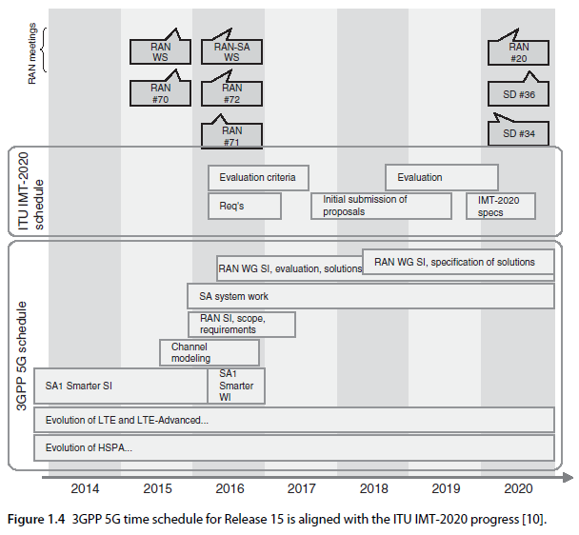
B) 3GPP

Slide 33
B) 3GPP
As for the development of the security aspects, 3GPP SA3 has produced the 5G security specification TS 33.501, V15.2.0. Some of the most important topics relevant to UICC follow:
Tamper-resistant hardware is mandatory for key storage, key derivation, and running the authentication algorithm. Please note that it is not explicitly stated that this applies for both 3GPP and non-3GPP networks and for both primary and secondary authentication.
Both Extensible Authentication Protocol (EAP) Authentication and Key Agreement (AKA’) and 5G AKA are mandatory to be supported for accessing 5G network using a primary authentication.
4G and 5G AKA are similar with enhancement on the Authentication Confirmation message.
EAP AKA’ will also be used to access non-3GPP networks.
256-bit algorithms are required in 5G.
New 5G user identifiers are SUPI (Subscription Permanent Identifier), SUCI (Subscription Concealed Identifier) and 5G-GUTI (5G Globally Unique Temporary Identity).

Slide 34
B) 3GPP
As for the radio interface, the most remarkable news of 2017 was the decision to include the 3GPP’s 5G Next Radio (NR) work item for the non-standalone mode, i.e. for the scenarios with 5G radio base station relying on 4G Evolved Packet Core (EPC). At the same time, there was agreement on:
Stage 3 for non-standalone 5G-NR evolved Multimedia Broadband (eMBB) includes low-latency support.
4G LTE EPC network will be reused.
The control plane on EPC-eNB-user equipment (UE) will be reused.
An additional next-generation user plane is adapted on NR gNB–UE.
The 3GPP Release 15 was formally frozen on June 2018, meaning that no new work items were accepted into that release. Release 15 thus contains the first phase of 5G and standalone (SA) modes.
The ASN.1 notation for the NSA was ready on March 2018, while the ASN.1 for the SA variant was ready September 2018. These notation documents are in practice the implementation guides for the equipment manufacturers, and based on these, the first standard-based lightweight 5G networks were deployed soon after.
The second phase of 5G as defined by 3GPP Release 16 with full functionality can be expected to be reality a few months after the freezing of the Release 16 ASN.1 notation set, meaning that the first IMT-2020-compatible 3GPP-based 5G networks will be deployed during 2020.These networks can support also the rest of the 5G pillars in addition to the eMBB, i.e. massive Internet of Things (mIoT) and critical communications referred to as ultra reliable low latency communications (URLLC).

Slide 35
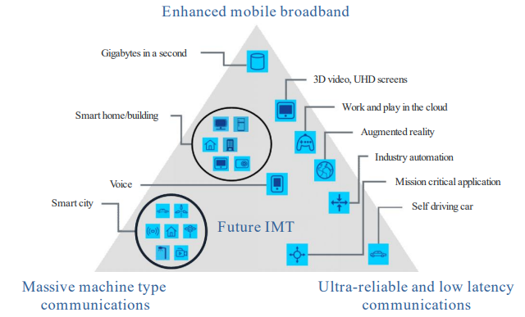
IMT 2020

Slide 36
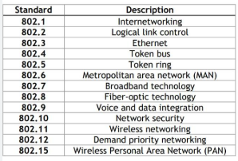
Institute of Electrical and Electronics Engineers (IEEE) Standards

Slide 37
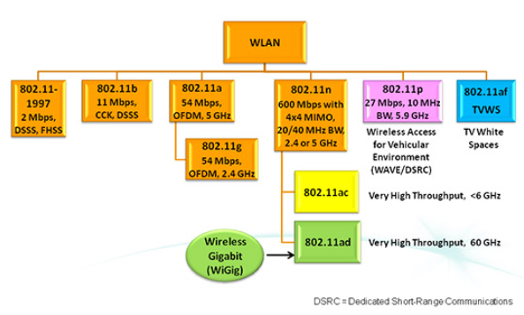
IEEE 802.11 / Wireless LAN

Slide 38
Global Standardization in 5G Era
The following sections summarize some of the key standardization bodies and industry forums that influence 5G either directly or indirectly, as well as the ones dealing with IoT standardization paving the way for the IoT in the 5G era.
1) GlobalPlatform
GlobalPlatform is a standardization body with interest areas covering, e.g. UICC and embedded UICC (eUICC), Secure Element (SE), Secure Device, trusted service manager (TSM), certification authority (CA), and TEE. The key standards of the GlobalPlatform related to the IoT include the embedded UICC protection profile, and the body has established an IoT task force. The respective solutions are also valid in 5G, including all the form factors of UICCs (such as embedded and integrated) and their remote management.

Slide 39
Global Standardization in 5G Era
2) ITU
The International Telecommunications Union (ITU) is a standardization body with a variety of global telecommunications-related requirements and standards. ITU has a leading role in setting the expectations for the 5G era, and the IMT-2020 requirements are the reference for these performance expectations.
As for the development of IoT, the ITU has an IoT Global Standards Initiative (IoT-GSI) established in 2015, as well as a study group 20 on IoT, applications, smart cities, and communities. The aim of the ITU is to ensure a unified approach in ITU-T for development of standards enabling the IoT on a global scale. The key IoT-related standard is the Rec. ITU-T Y.2060 (06/2012). It can be expected that the massive IoT will be a major component of the 5G pillars, along with the eMBB and Critical Communications.The ITU-T SG-20 deals with IoT and its applications, including smart cities and communities (SC&C). The resulting standard is designed for IoT and smart cities. There also is an international standard for the development of IoT including M2M communications and sensor networks .
The IoT-GSI concluded its activities in July 2015 following Telecommunication Standardization Advisory Group’s (TSAG) decision to establish the new Study Group 20 on IoT and its applications including smart cities and communities. All activities ongoing in the IoT-GSI were transferred to the SG20. The IoT-GSI aimed to promote a unified approach in ITU-T for the development of technical standards enabling the IoT on a global scale. ITU-T recommendations developed under the IoT-GSI by the various ITU-T questions, in collaboration with other standards developing organizations (SDOs), will enable worldwide service providers to offer the wide range of services expected by this technology. The IoT-GSI also acts as an umbrella for IoT standards development worldwide.

Slide 40
Global Standardization in 5G Era
3) IETF
The Internet Engineering Task Force (IETF) develops the Internet architecture. The IETF has dedicated IETF Security Area. Some of the key standards include the Constrained Application Protocol (CoAP), and adaptation to the current communication security for usewith CoAP. There also is the standard for IPv6 Low-power Wireless Personal Area Network (6LoWPAN).
4) 3GPP/3GPP2
3GPP and its US counterparty 3GPP2 focus on cellular connectivity specifications that have been actively widened to cover also low-power wide area network (LPWAN) area. These include most concretely LTE-M and category 0 for low-bit rate M2M, and the further enhanced terminal categories that are optimized for IoT such as Cat-M1 and NB-IoT. The standardization body also develops security aspects, 2G/3G/4G/5G security principles and architectures, algorithms, lawful interception, key derivation, backhaul security, and SIM/UICC that can give added value for the cellular IoT compared to the competing proprietary variants.
5) ETSI
The European Telecommunications Standards Institute (ETSI) executes security standardization of, e.g. UICC and its evolution under the term SSP (smart secure platform). The latter is a continuum that opens room for new forms of UICCs such as embedded and integrated UICCs. The ETSI Technical Committee (TC) M2M is a relevant group for IoT development at ETSI.

Slide 41
Global Standardization in 5G Era
6) IEEE
The Institute of Electrical and Electronics Engineers (IEEE) 802 series includes aspects for IoT connectivity. There also exist many other related standards useful for IoT environment, like the IEEE Std 1363 series for public key cryptography. The IEEE 802.11 has many variants from which e.g. 802.11p is designed specifically for vehicle-to-vehicle (V2V) communications. That can be considered as a competing technology for the 3GPP-based modes that will be optimized for vehicle communications, especially in the 5G era.
The IEEE Project P.2413 revises IEEE standards for better use within the IoT. The goal of the project is to build reference architecture covering the definition of basic architecture building blocks and integration into multitiered systems. The architectural framework for IoT provides a reference model that defines relationships among various IoT verticals, including transportation and health care, as well as common architecture elements. It also provides means for data abstraction, protection, security, privacy, and safety.The reference architecture of the project covers the basic architectural building blocks and their ability to be integrated into multitiered systems.
7) SIM alliance
The task of SIM alliance is to simplify SE implementation, and it drives deployment and management of secure mobile services. It also promotes SE for secure mobile applications and services and promotes subscription management standardization, which is beneficial to provide a standardized means for the remote management of embedded universal integrated circuit card (eUICC) and integrated universal integrated circuit card (iUICC), which can be expected to be elemental components of 5G ecosystem.

Slide 42
Global Standardization in 5G Era
8) Smart Card Alliance
Smart Card Alliance (SCA) has been a centralized industry interface for smart card technology, and it has followed the impact and value of smart cards in the United States and Latin America. As the 5G IoT can be based largely on the basic concept of the SIM card, and thus smart card technology, this task continues being relevant in the 5G era as well. From its inception as the SCA, its current form of Secure Technology Alliance (STA) facilitates the adoption of secure solutions in the United States. The Alliance’s focus is set on securing a connected digital world by driving adoption of new secure solutions.
9) GSMA
The GSM Association (GSMA) represents interests of MNOs worldwide. It is involved in the Network 2020 paving the way for 5G. GSMA is involved in the standardization of subscription management and embedded Subscriber Identity Module (eSIM), and their development forM2Mand consumer environment. It should be noted that the previous term of GSMA for indicating remote Subscriber Identity Module provisioning (RSP) is now generalized via the term eSIM, which has been approved by the GSMA as a global product label that can be used to indicate that a device is “RSP enabled”.
10) NIST
The US National Institute of Standards Technology (NIST) develops cybersecurity frameworks to address critical infrastructure including IoT/M2M space. The focus is on security and privacy for the evolution of IoT and M2M. It produces Federal Information Processing Standards Publications (FIPS PUBS). FIPS are developed by the Computer Security Division within the NIST for protecting federal assets such as computer and telecom systems. FIPS 140 (1–3) contains security requirements.

Slide 43
Global Standardization in 5G Era
11) NHTSA
The National Highway Transportation and Safety Administration (NHTSA) improves safety and mobility on US roadways. It also investigates connected vehicle technology and communications of safety and mobility information to one another. It has International Technical Working Group on IoT-Enabled Smart City Framework.
12) ISO/IEC
The International Organization for Standardization (ISO)/International Electrotechnical Commission (IEC) is an elemental body for smart card technology standardization. ISO/IEC 7816 and 14400 are SIM/UICC standards for contact-oriented and contactless integrated circuit cards (ICCs).There are various solutions in themarkets based on these standards, including transport cards, and IoT devices can be expected to be based largely on UICC. ISO/IEC 27000 is Information Security Management framework, which is valid also for IoT security.
Related to IoT security, the ISO/IEC Common Criteria (CC) is an international security evaluation framework that provides reliable IT product evaluation for the security capabilities based on an international standard (ISO/IEC 15408) for computer security certification,which refers to standards denoting EAL (evaluation assurance level) of 1–7. ISO/IEC 19794 produces biometrics standards.
13) ISO/IEC JTC1
Joint Technical Committee (JTC) 1 is the standards development environment to develop worldwide information and communication technology (ICT) standards for business and consumer applications. Additionally, JTC 1 provides the standards approval environment for integrating diverse and complex ICT technologies. ISO/IEC JTC 1/SC 27 deals with IT security techniques.

Slide 44
Global Standardization in 5G Era
14) OMA
Open Mobile Alliance (OMA) has developed device management (DM). OMA Lightweight M2M aims to optimize the secure communications between all, economic, devices. OMA DM is a subgroup under the OMA alliance. OMA DM is an initiative for automotive environment, and it includes over the air (OTA) updates for future investigations. The role of OMA is detailed in [34].
15) CEPT/ECC
Conférence Européenne des Postes et des Télécommunications (CEPT) and Electronic Communications Committee (ECC) are coordinated by European Communications Office (ECO). They produce requirements for approval for certification bodies and testing labs. They work in the ECC on smart grids, smart metering, and others under the ultra-high frequency (UHF) roadmap. Related to IoT environment, there is an ECC Report 153 on Numbering and Addressing in M2M Communications.
M2M can be used in several licensed and unlicensed frequency bands. The aim of ECC is to understand better the spectrum as well as numbering and addressing harmonization needs of existing and future M2M applications since related initiatives are present in various for a within the ECC, aligning with industry. The Working Group for Frequency Management (WGFM) of the ECC had prepared information to the ECC on the regulatory framework for M2M communications on the basis of frequency bands already available for various M2M usages;
16) NERC
Indirectly related to IoT, North American Electric Reliability Corporation (NERC) is committed to protecting the bulk power system against cybersecurity compromises that could lead to faulty operation or instability. CIP refers to Critical Infrastructure Protection cybersecurity standards, the CIP V5 Transition Program being the most recent one in the United States.
17) OWASP
Open Web Application Security Project (OWASP) is a worldwide not-for-profit charitable organization focused on improving the security of software. OWASP IoT Project provides information on IoT attack surface areas and IoT testing guides and maintains a top-10 IoT vulnerabilities list.

Slide 45
Global Standardization in 5G Era
18) OneM2M
OneM2M’s architecture and standards for M2M communications are designed to be applied in many different industries and take account of input and requirements from any sector. It works on eHealth and Telemedicine, Industrial, and Home Automation.
19) Global Standards Collaboration
Global Standards Collaboration (GSC) is an unincorporated voluntary organization dedicated to enhancing global cooperation and collaboration regarding communications standards and the related standards development environment. GSC is not a standards development organization and therefore will not develop standards. The members of GSC include ARIB (Association of Radio Industries and Businesses in Japan),ATIS (Alliance for Telecommunications Industry Solutions in the United States), CCSA (China Communications Standards Association), ETSI, IEC, IEEE-SA (IEEE Standards Association), ISO, ITU, TIA (Telecommunications Industry Association in the United States), TSDSI (Telecommunications Standards Development Society in India), TTA (Telecommunications Technology Association in Korea), and TTC (Telecommunication Technology Committee in Japan).
20) CSA
Cloud Security Alliance (CSA) is a nonprofit organization to promote the use of practices for providing security assurance within cloud computing and provide education on the uses of cloud computing to help secure all other forms of computing. CSA operates the cloud security provider certification program, the CSA Security, Trust & Assurance Registry (STAR), a three-tiered provider assurance program of self-assessment, third-party audit, and continuous monitoring. Cloud computing and data centers form an integral part of the 5G infrastructure.

Slide 46
Global Standardization in 5G Era
21) NGMN
Next Generation Mobile Networks (NGMN) is relevant for overall advanced network technologies as well as for the IoT. As an example, NGMN has launched a projects “Spectrum and deployment efficiencies,” “URLLC requirements for vertical industries,” “RAN convergence,” and “Extreme long-range communications for deep rural coverage.” These activities are aimed to optimize and guide the telecoms industry toward the successful deployment of 5G beyond 2018.
22) Car-to-Car Communication Consortium
Car-to-Car Communication Consortium (C2C-CC) is industry forum for the V2V technology development. It is a non-profit, industry driven organization initiated by European vehicle manufacturers and supported by equipment suppliers, research organizations, and other C2C-CCis dedicated to the objective of further increasing road traffic safety and efficiency by means of cooperative intelligent transport systems (C-ITS) with V2V communication supported by vehicle-to-infrastructure communication (V2I). It supports the creation of European standards for communicating vehicles spanning all brands. As a key contributor, the C2C-CC works in close cooperation with European and international standardization organizations.
23) 5GAA
The mission of the 5G Automotive Association (5GAA) is to develop, test, and promote communications solutions, initiate their standardization, and accelerate their commercial availability and global market penetration to address society’s connected mobility and road safety needs with applications such as autonomous driving, ubiquitous access to services, and integration into smart city and intelligent transportation. 5GAA offers several levels of membership for corporations, industry organizations, and academic institutions.

Slide 47
Global Standardization in 5G Era
24) Trusted Computing Group
Through open standards and specifications, Trusted Computing Group (TCG) enables secure computing. Some benefits of TCG technologies include protection of business-critical data and systems, secure authentication and protection of user identities, and the establishment of machine identity and network integrity. The work groups are cloud; embedded systems; infrastructure; IoT; mobile; PC client; regional forums; server; software stack; storage; trusted network communications; trusted platform module (TPM); and virtualized platform.
25) InterDigital
InterDigital, Inc. designs and develops advanced technologies that enable and enhance mobile communications and capabilities for concept of the Living Network basing on intelligent networks, which self-optimize to deliver services tailored to the content, context and connectivity of the user, device, or need. Ecosystem partners providing devices,platforms, and data services, and affiliations include One M2M, Industrial Internet Consortium, and Convida

Slide 48
5G Requirements Based on ITU
The idea of 5G was presented as early as 2012 when ITU-R initiated a program to develop IMT for the year 2020 and beyond.
ITU has played an essential role in the development of mobile radio interface standards. The previous requirements of the ITU ensuring the internationally recognized systems for 3G (IMT-2000) and 4G (IMT-Advanced) is now extending to cover 5G via the IMT-2020 requirements.
The 5G (IMT2020) work item categories include the following:
Vision and technology trends (These aspects include also market, traffic, and spectrum requirements for the forthcoming 5G era).
Frequency band (spectrum sharing and compatibility).
IMT specifications (technical details).
Support for IMT applications and deployments.

Slide 49
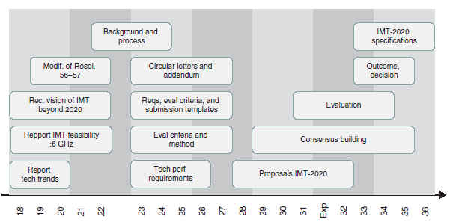
5G Requirements Based on ITU
The main phases of the IMT-2020 development by the ITU

Slide 50
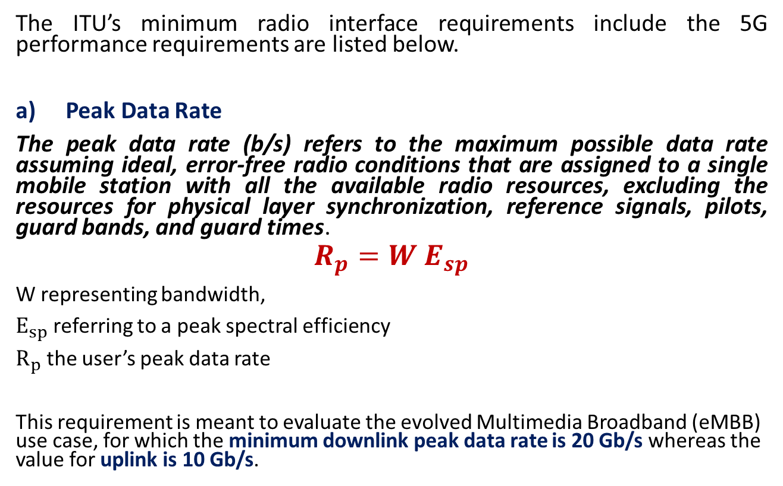
5G Requirements Based on ITU
The ITU’s minimum radio interface requirements include the 5G performance requirements are listed below.
Peak Data Rate
The peak data rate (b/s) refers to the maximum possible data rate assuming ideal, error-free radio conditions that are assigned to a single mobile station with all the available radio resources, excluding the resources for physical layer synchronization, reference signals, pilots, guard bands, and guard times.
$$R_{p}=W E_{sp}$$
W representing bandwidth,
$E_{sp}$ referring to a peak spectral efficiency
$R_{p}$ the user’s peak data rate
This requirement is meant to evaluate the evolved Multimedia Broadband (eMBB) use case, for which the minimum downlink peak data rate is 20 Gb/s whereas the value for uplink is 10 Gb/s.

Slide 51
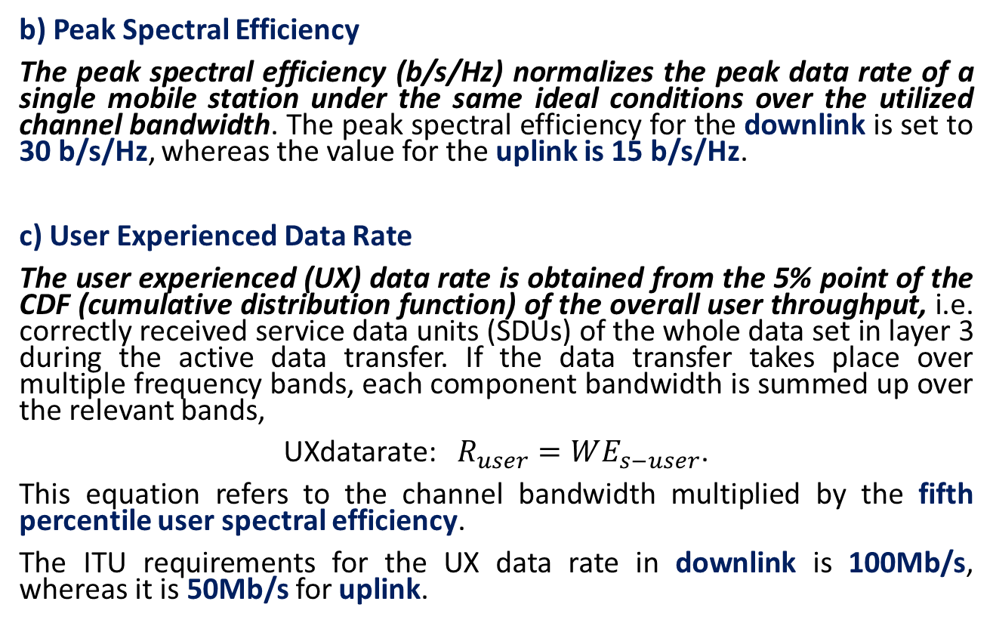
5G Requirements Based on ITU
b) Peak Spectral Efficiency
The peak spectral efficiency (b/s/Hz) normalizes the peak data rate of a single mobile station under the same ideal conditions over the utilized channel bandwidth. The peak spectral efficiency for the downlink is set to 30 b/s/Hz, whereas the value for the uplink is 15 b/s/Hz.
c) User Experienced Data Rate
The user experienced (UX) data rate is obtained from the 5% point of the CDF (cumulative distribution function) of the overall user throughput, i.e. correctly received service data units (SDUs) of the whole data set in layer 3 during the active data transfer. If the data transfer takes place over multiple frequency bands, each component bandwidth is summed up over the relevant bands,
UXdatarate: $R_{user}=WE_{s−user}$.
This equation refers to the channel bandwidth multiplied by the fifth percentile user spectral efficiency.
The ITU requirements for the UX data rate in downlink is 100Mb/s, whereas it is 50Mb/s for uplink.

Slide 52
5G Requirements Based on ITU
d) Fifth Percentile User Spectral Efficiency
The fifth percentile user spectral efficiency refers to the 5% point of the CDF of the normalized user data throughput. The normalized user throughput (b/s/Hz) is the ratio of correctly received SDUs in layer 3 during selected time divided by the channel bandwidth.
This requirement is applicable to eMBB use case, and the requirement values are, for downlink and uplink, respectively, the following:
Indoor hotspot. 0.3 b/s/Hz (DL) and 0.21 b/s/Hz (UL).
Dense urban. 0.225 b/s/Hz (DL) and 0.15 b/s/Hz (UL), applicable to the Macro TRxP (Transmission Reception Point) layer of Dense Urban eMBB test environment.
Rural. 0.12 b/s/Hz (DL) and 0.045 b/s/Hz (UL), excluding the LMLC (low mobility large cell) scenario.

Slide 53
5G Requirements Based on ITU
e) Average Spectral Efficiency
Average spectral efficiency can also be called spectrum efficiency, as has been stated in ITU Recommendation ITU-R M.2083.
It refers to the aggregated throughput, taking into account the data streams of all the users.
The ITU requirement values are, for downlink and uplink for eMBB use case, respectively, the following:
Indoor hotspot. 9 b/s/Hz/TRxP (DL) and 6.75 b/s/Hz/TRxP (UL).
Dense urban for macro TRxP layer. 7.8 b/s/Hz/TRxP (DL) and 5.4 b/s/Hz/TRxP (UL).
Rural (including LMLC). 3.3 (DL) and 1.6 (UL).

Slide 54
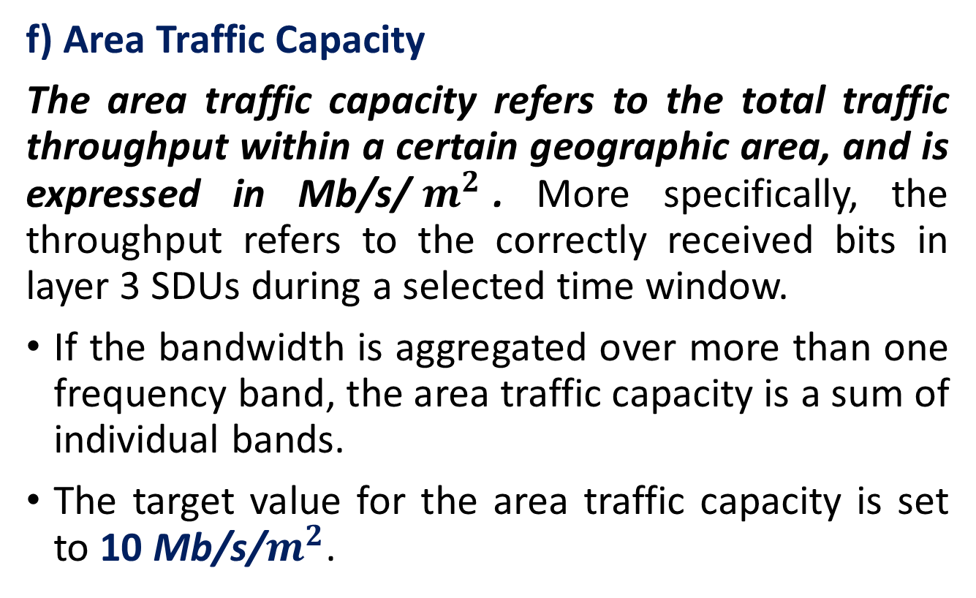
5G Requirements Based on ITU
f) Area Traffic Capacity
The area traffic capacity refers to the total traffic throughput within a certain geographic area, and is expressed in Mb/s/$m^{2}$. More specifically, the throughput refers to the correctly received bits in layer 3 SDUs during a selected time window.
If the bandwidth is aggregated over more than one frequency band, the area traffic capacity is a sum of individual bands.
The target value for the area traffic capacity is set to 10 Mb/s/$m^{2}$.

Slide 55
5G Requirements Based on ITU
g) Latency
The user plane latency refers to the time it takes for the source sending a packet in radio protocol layer 2/3 to reach its destination on the respective layer. The latency is expressed in milliseconds.
The requirement for the user plane latency is 4 ms for eMBB use case, whilst it is 1ms for ultra-reliable low latency communications (URLLCs).
The assumption here is an unloaded condition in both downlink and uplink without other users than the observed one whilst the packet size is small (zero payload and only IP header).
The control plane latency, in turn, refers to the transition time it takes to change from the idle stage to the active stage in URLLC use case. The requirement for the control plane latency is maximum of 20 ms, and preferably 10 ms or less.

Slide 56
5G Requirements Based on ITU
h) Connection Density
Connection density refers to the total number of 5G devices that can still comply with the target QoS (quality of service) level within a geographical area which is set to 1 sq-km, with a limited frequency bandwidth and the number of the TRxPs, the variables being the message size, time and probability for successful reception of the messages.
This requirement applies to the massive machine-type communications (mMTCs) use case, and the minimum requirement for the connection density is set to 1,000,000 devices per sq-km.

Slide 57
5G Requirements Based on ITU
i) Energy Efficiency
The high-level definition of the 5G energy efficiency indicates the capability of the radio interface technology (RIT) and set of RITs (SRIT) to minimize the radio access network (RAN) energy consumption for the provided area traffic capacity.
Furthermore, the device energy efficiency is specifically the capability of the RIT and SRIT to optimize the consumed device modem power down to a minimum that still suffices for the adequate quality of the connection.
For the energy efficiency of the network as well as the device, the support of efficient data transmission is needed for the loaded case, and the energy consumption should be the lowest possible for the cases when data transmission is not present.
For the latter, the sleep ratio indicates the efficiency of the power consumption.
Energy efficiency is relevant for the eMBB use case, and the RIT and SRIT must have the capability to support a high sleep ratio and long sleep duration.

Slide 58
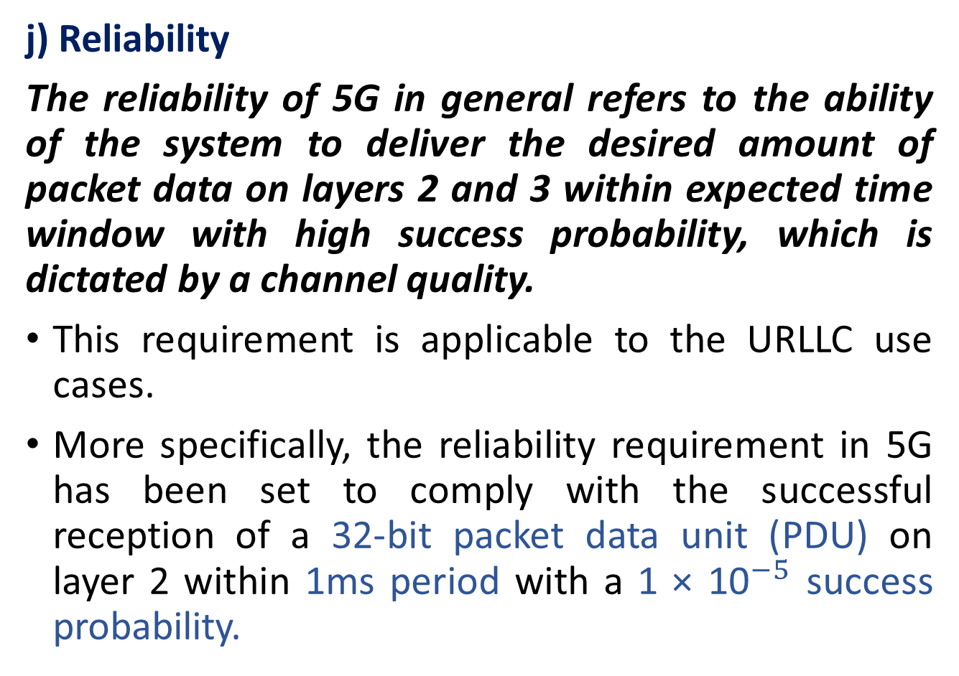
5G Requirements Based on ITU
j) Reliability
The reliability of 5G in general refers to the ability of the system to deliver the desired amount of packet data on layers 2 and 3 within expected time window with high success probability, which is dictated by a channel quality.
This requirement is applicable to the URLLC use cases.
More specifically, the reliability requirement in 5G has been set to comply with the successful reception of a 32-bit packet data unit (PDU) on layer 2 within 1ms period with a 1 × ${\text{10}}^{−5}$ success probability.

Slide 59
5G Requirements Based on ITU
k) Mobility
The 5G mobility requirement refers to the maximum mobile station speed in such a way that the minimum QoS requirement is still fulfilled.
There is a total of four mobility classes defined in 5G:
stationary with 0 km/h speed;
pedestrian with 0–10 km/h;
Vehicular with 10–120 km/h;
high-speed vehicular with speeds of 120–500 km/h.
The applicable test environments for the mobility requirement are indoor hotspot eMBB (stationary, pedestrian), dense urban eMBB (stationary, pedestrian, and vehicular 0–30 km/h), and rural eMBB (pedestrian, vehicular, high-speed vehicular).

Slide 60
5G Requirements Based on ITU
l) Mobility Interruption Time
The mobility interruption time refers to the duration of the interruption in the reception between the user equipment (UE) and base station, including RAN procedure execution, radio resource control (RRC) signaling or any other messaging.
This requirement is valid for eMBB and URLLC use cases and is set to 0ms.
m) Bandwidth
The bandwidth in 5G refers to the maximum aggregated system bandwidth and can consist of one or more radio frequency (RF) carriers.
The minimum supported bandwidth requirement is set to 100MHz, and the RIT/SRIT shall support bandwidths up to 1 GHz for high-frequency bands such as 6 GHz.

Slide 61
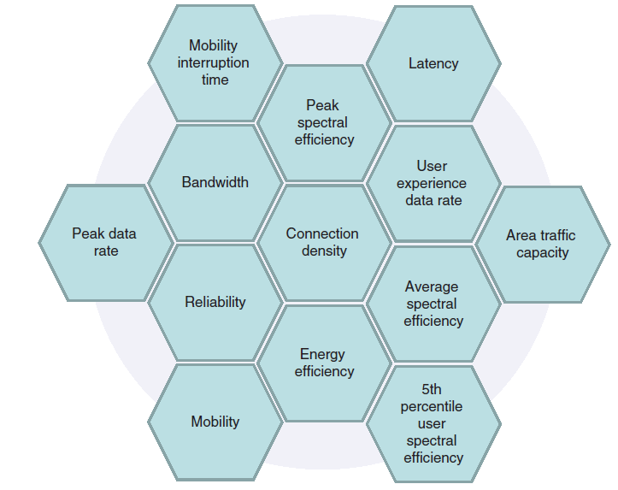
5G Requirements Based on ITU
As summary of ITU’s IMT-2020 requirement categories for 5G

Slide 62
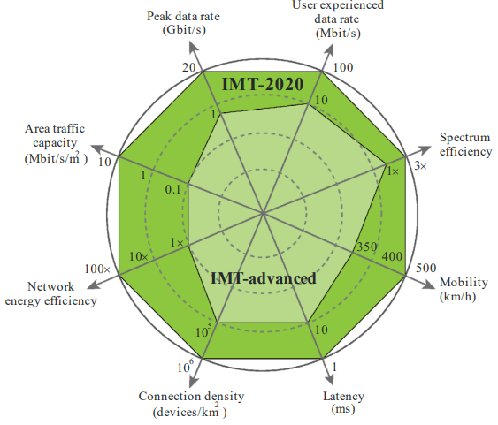
5G Requirements Based on ITU

Slide 63
The Technical Specifications of 3GPP
In 3GPP Release area 15, The 5G requirements of the ITU-R with the enhancement of the LTE, Some of the specifications are as follows:
• Uplink data compression (UDC). This is a feature that would be implemented between evolved NodeB (eNB) and UE. The benefit of the UDC is the compression gain especially for web browsing and text uploading, and the benefits cover also the online video performance and instant messaging. The result is thus the capacity enhancement and better latency in the uplink direction especially in the challenging radio conditions.
• Enhanced LTE bandwidth flexibility. This item aims to further optimize the spectral efficiency within the bandwidths of 1.4–20MHz.
• Enhanced Voice over Long-Term Evolution (VoLTE) performance. This item refers to the maintenance of the voice call quality sufficiently high to delay the Single Radio Voice Call Continuity (SRVCC), thus optimizing the signaling and network resource utilization.
• Virtual reality. This item refers to the innovation of potential use cases and their respective technical requirements on virtual reality.

Slide 64
The Technical Specifications of 3GPP
•NR-based access to unlicensed spectrum. This item is related to the advanced phase of the Release 15 by investigating further the feasibility of license assisted access (LAA) both below and above 6 GHz frequency band, such as 5, 37, and 60 GHz.
• NR support on non terrestrial networks. This item refers to the channel models and system parameters respective to the non terrestrial networks, to support satellite systems as one part of the 5Gecosystem.
• Enablers for network automation for 5G. This item relates to the automatic slicing network analysis, based on network data analytics (NWDA).
• System and functional aspects of energy efficiency in 5G networks. This item refers to the overall topic of energy efficiency (EE). The subtopics include EE key performance indicators (KPIs) relevant to the 5G system, including the ones identified by European Telecommunications Standards Institute (ETSI) TC EE, ITU-T (Telecommunication Standardization Sector of ITU) SG5, and ETSI Network Functions Virtualization (NFV) ISG.

Slide 65
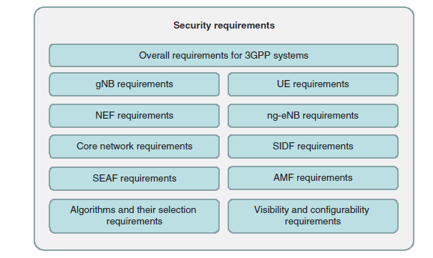
Security Requirements for 5G
The 3GPP security requirement categories

Slide 66
Security Requirements for 5G
Overall Security Requirements
The generic security requirements of the 3GPP TS 33.501 cover the following cases:
UE must include protection against bidding-down attack.
The bidding-down attack refers to the intentions to modify the functionality of the UE and/or network to make it believe that the networks and/or UE would not support security features. This may lead to security breaches by forcing reduction of the security measures between the UE and network.
Network must support the subscription authentication and key agreement (AKA).
The subscription AKA is based on a 5G-specific identifier SUPI (Subscription Permanent Identifier).

Slide 67
Security Requirements for 5G
Each mobile equipment (ME) must support unauthenticated emergency services, which refers to the possibility to make an emergency call even without the subscription credentials of the Universal Integrated Circuit Card (UICC). In other words, the ME must be able to execute emergency calls without the Universal Subscriber Identity Module (USIM). This requirement applies only to serving networks that are dictated by local regulation to support such service. Where regulation does not allow this service, the serving networks must not provide with the unauthenticated emergency services.

Slide 68
Security Requirements for 5G
The 5G UE must comply with the following requirements
Ciphering and integrity protection
User data and signaling data confidentiality
User data and signaling data integrity
Secure storage and processing of subscription credentials
Subscriber privacy

Slide 69
Key requirements for gNB
User data and signaling data confidentiality
User data and signaling data integrity
gNB setup and configuration
gNB key management
Handling of user and control data for the gNB
Secure environment of the gNB
gNB F1 interfaces
gNB E1 interfaces

Slide 70
Other security Functions
SEAF is to support primary authentication using SUCI.
The Network Exposure Function (NEF) provides external exposure of network function (NF) capabilities to the application function (AF).
Subscription Identifier De-concealing Function (SIDF) is to resolve the SUPI from the SUCI.

Slide 71
Core Network
Trust Zones: The 5G systems provide the possibility forMNO to divide the network into trust boundaries, or zones.The default assumption is that two different MNOs are not sharing a single trust zone.
Service-Based Architecture: The 5G system allows the service-based architectural model, which is novel concept compared to the previous generations. The respective security requirements for service registration, discovery, and authorization include the following:
NF service-based discovery and registration supports confidentiality, integrity, and replay protection, and there must be assurance that the NF discovery and registration requests are authorized.
NF service-based discovery and registration can hide the topology of the NFs between trust domains, e.g. between home and visited networks.
NF service request and response procedure supports mutual authentication between NFs.
There must be a mutual authentication between Network Repository Function (NRF) and the set of NFs requesting service from it.
End-to-End Core Network Interconnection Security: The end-to-end security solution supports application-layer mechanisms for addition, deletion, and modification of message elements handled by intermediate nodes, excluding special message elements such as those related to routing in Internet Protocol Packet eXchange (IPX) environment.

Slide 72
The 5G Security
It can be generalized that the trust of the 5G system is a concept consisting of security, identity, and privacy:
Specifically, for the security aspects, the NGMN states that the operator is the partner for state-of-the-art data security, running systems that are hardened according to recognized security practices, to provide security levels for all communication, connectivity, and cloud storage purposes.
The identity refers to the operators’ special role in the security, which is the trusted partner for master identity. The MNO provides secure, easy-to-use single sign-on and user profile management to fit all communication and interaction demand.
The privacy refers to the operators’ special role in partnering to safeguard sensitive data, while ensuring its transparency.

Slide 73
Next Generation Mobile Network (NGMN)
The NGMN is an open forum for participants to facilitate the evaluation of candidate technologies suitable for the evolved versions of wireless networks.
The NGMN states the urgent need to fortify the following aspects of the networks to prepare MNOs to better tackle the new threats by improving:
Resilience against signaling-based threats, including direct attacks and overloading of the signaling channels
Security design for very low latency use cases for initial signaling and during the communications;
Security requirements originated in the 4G technical specifications.

Slide 74
References
[Chapter. 1, 2] 5G explained: security and deployment of advanced mobile communications by Jyrki T.J. Penttinen. Hoboken, NJ, USA: John Wiley & Sons, Inc., 2019.

Slide 75
Thank you

